Slide 1
Chapter 4 Array
C Language Programming
--To represent the complex data

Slide 2
Contents
4.1 One-dimensional array
4.2 Two-dimensional array
4.3 Character array and string
4.4 Array and function

Slide 3
4.1 One-dimensional array
Background
Makes possible the representation of a large number of homogeneous values.
Array's feature
The same type
Limited numbers
Store in sequence

Slide 4
4.1 One-dimensional array
How to declare one-dimensional array?
<data type> <array-name>[<constant expression>];
const int N = 20 ;
const int M = 40 ;
const int MaxStringSize = 80 ;
const int MaxListSize = 1000 ;
int A[10] ;
char B[MaxStringSize] ;
double C[M * N] ;
int Values[MaxListSize] ;
C[0]
C[1]
C[2]
C[3]
C[4]
：
A[0]
A[1]
A[2]
A[3]
A[4]
A[5]
A[6]
A[7]
A[8]
A[9]
B[0]
B[1]
B[2]
:
:
B[11]
B[12]
B[13]
:
:
…
…
数组A
数组B
数组C

Slide 5
4.1 One-dimensional array
How to initialize one-dimensional array?
int a[5] = { 1, 3, 5, 7, 9 }; // all elements are assigned
int b1[5] = { 0 }; // all elements are initialized by 0
int b2[5] = { 1, 2, 3}; // b2[3], b2[4] are a assigned by 0
int c[ ] = { 1, 2, 3, 4, 5, 6, 7 }; // the size of array is decided by 7
int d[5] = { 1, 2, 3, 4, 5, 6, 7 }; // error, too many data

Slide 6
4.1 One-dimensional array
How to access array elements(or members)?
int ary[10], i = 3, j = 5;
ary [ 0 ]
ary [ 1 ]
ary [ 2 ]
ary [ 3 ]
ary [ 4 ]
ary [ 5 ]
ary [ 6 ]
ary [ 7 ]
ary [ 8 ]
ary [ 9 ]
10
ary [ 0 ] = 10
10
ary [ ary [ i ] ] = ary [ 0 ]
2
ary [ i ] = 2
2
ary [ j ] = ary [ i ]
31
ary [ 2+j ] = 31

Slide 7
4.1 One-dimensional array
One example (N is a constant)
Randomly generate N scores
Minimal value
Maximum value
Mean value
Summation
Bubble sort
Notes:
#include <stdio.h>
#include <stdlib.h>
#include <time.h>
int main(){
const int N = 20;
int i,j, a[N];
// generate a random seed according to system time
srand(time(NULL));
// randomly generate N integer data
for (i = 0; i < N; i ++)
a[i] = rand() % 101;
// output all elements of the array (before sorted)
for (i = 0; i < N; i ++)
printf("%d ", a[i]);
printf("\n");
// bubble sort
for (i = 0; i < N - 1; i ++){
for (j = 0; j < N - i - 1; j ++){
if (a[j] > a[j +1]) {
int t = a[j];
a[j] = a[j +1];
a[j +1] = t;
}
}
}
// output all elements of the array (after sorted)
for (i = 0; i < N; i ++)
printf("%d ", a[i]);
printf("\n");
return 0;
}

Slide 8
4.1 One-dimensional array
Summary
All elements of array have the same data type
The size of array cannot be changed after declared
To access array elements by name and subscript (from 0 to length-1, length is the number of array elements),
C language do not checks the validity of array subscript

Slide 9

4.2 Two-dimensional array
How to describe the data as follows:
$$\left[\begin{matrix}3 & 6 & 0 \\ 4 & 5 & 13 \\ 3 & 7 & 2\end{matrix}\right]$$

Slide 10
4.2 Two-dimensional array
How to declare two-dimensional array?
<data type> <identity>[<constant expression 1>][<constant expression 2>];
For examples
int rectangle[60][2];
char months[12][20];
const int N=100,M=3;
double scores[N][M+1];

Slide 11
4.2 Two-dimensional array
How to access two-dimensional array?
<array-name>[<row subscript>][<column subscript>]
For examples
int A[5][5];
A[0][0]=2;
A[0][1]=7;
A[1][0]=8;
A[1][1]=1;
A[2][1]=5;
A[2][2]=4;
int sum=A[0][0]+ A[1][1]+ A[2][2];
printf("%d %d %d %d\n", &a[0][0], &a[1][1], &sum);

Slide 12
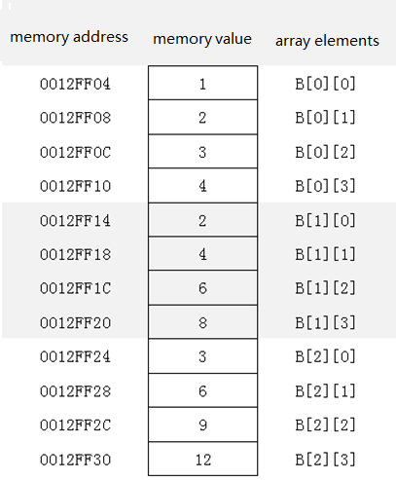
4.2 Two-dimensional array
How to store two-dimensional array?
int B[3][4];
int i,j;
for(i=0;i<3;i++)
{
for(j=0;j<4;j++)
B[i][j]=(i+1)*(j+1);
}

Slide 13
4.2 Two-dimensional array
How to initialize two-dimensional array?
<data type> <identity>[<row count>][<column number>]={<expression 1>,<expression 2>,...};
Several examples
int a=9;
int B[3][3]={a+1,a+2,a+3,a+4,a+5,a+6,a+7,a+8,a+9};
int A[5][4]={2,7,6,8,1,3,10,5,4};
int A[][3]={2,7,6,8,1,3,10,5,4};
int A[3][3]={{2,7,6},{8,1,3},{10,5,4}};
int A[3][3]={{2,7},{8,1},{10,5}};

Slide 14
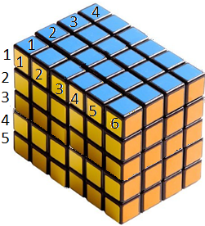
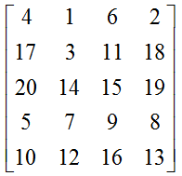
4.2 Two-dimensional array
From two-dimensional to multi-dimensional array
int A[4][5][6]
double B[3][4][5][6]

Slide 15
4.2 Two-dimensional array
One example
Calculate and output the maximum and minimum values of two-dimensional array elements, and their subscripts.

Slide 16
4.3 Character array and string
One-dimensional character array
String constant: end by '\0' character
"students", "I like C language."
Declare character array and initialize it
Input/output character array
input/output array by its elements
Input/output array by its name
char a[5] = {'b', 'o', 'o', 'k','s'};
char b[] = {'b', 'o', 'o', 'k','s'};
char c[6] = {'b', 'o', 'o', 'k', 's', '\0'};
char d[6] = "books“;
char e[] = "广东金融学院20级";
Notes:
#include <stdio.h>
void main()
{
char a[5] = {'b', 'o', 'o', 'k','s'};
char b[] = {'b', 'o', 'o', 'k','s'};
char c[] = "I like C language.";
// output array by its elements
int i;
printf("output array by its elements:\n");
for (i = 0; i < 5; i ++)
printf("%c ", a[i]);
printf("\n");
for (i = 0; i < 5; i ++)
printf("%c ", b[i]);
printf("\n");
for (i = 0; i < 5; i ++)
printf("%c ", c[i]);
printf("\n");
// output array by its name
printf("output array by its name:\n");
printf("%s", a);
printf("%s", b);
printf("%s", c);
}

Slide 17
4.3 Character array and string
Several examples
1. input a string, then:
Get the number of uppercase, lowercase, number and others
Inverse an array

Slide 18
4.3 Character array and string
Some string library function prototypes:
int strlen(const char[])
char* strcpy(char [], const char [])
char* strcat(char [], const char[])
int strcmp(const char [], const char [])

Slide 19
4.4 Array and function
array elements as function argument
Argument: <data type> variable
Actual parameter: array-name[<subscript>]
one-dimensional array as function argument
Argument: <data type> <array-name>[]
Actual parameter: <array-name>

Slide 20
4.4 Array and function
An example
The modularization of score statistic program

Slide 21
Summary
1. One-dimensional array
2. Two-dimensional array
3. Character array and string
4. Array and function

